Slide 1

Dense Coding and Teleportation
Giuseppe Prisco (1895709) – Topics in Physics

Slide 2
Index
Introduction
Quantum Computing
Photon Polarization
Bra/Ket Notation
What is a Qubit?
Multiple Qubits
Entanglement
Simple Quantum Gates
Controlled-NOT Gate
Walsh-Hadamard Transformation
Dense coding
Teleportation
Security of Dense Coding and Teleportation

Slide 3
Quantum Computing (1)
Quantum Computing is a field of computer science that uses quantum mechanics to process, elaborate and manipulate information
At the base of quantum computing is the notion of quantum bit, which differentiates from the classical bit in that in can be in a superposition of its two basic states
Classical computers require an exponential increase in the number of processors (and thus physical space needed) to achieve an exponential decrease in computational time

Slide 4
Quantum Computing (2)
On the other hand, in quantum systems the amount of parallelization increases exponentially with the size of the system
This means that an exponential decrease in computational time only requires a linear increase in the amount of physical space needed. This effect is called quantum parallelism
However, accessing the results is equivalent to making a measurement, which disturbs the quantum state, thus restricting the operations that can be performed

Slide 5
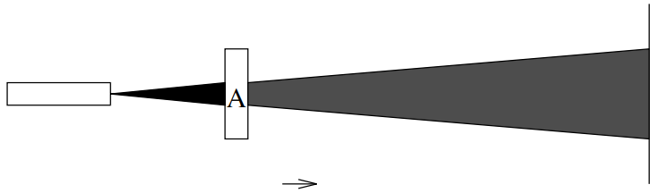
Photon Polarization (1)
The photon polarization experiment is used to demonstrate some of the principles of quantum mechanics and is composed of:
a strong beam of light
a filters A, polarized horizontally
a filter B, polarized at a 45° angle
a filter C, polarized vertically
If we assume that the light source is randomly polarized, when inserting only the filter A the resulting light intensity will be half of the incoming light.
In this case the filter does not act as a sieve since it would have attenuated the light intensity by a much larger amount.

Slide 6
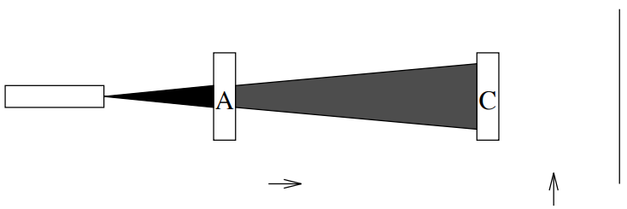
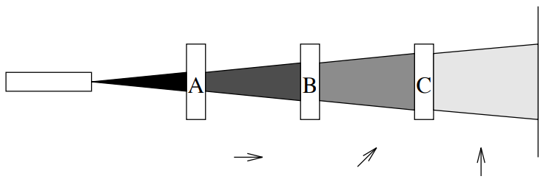
Photon Polarization (2)
If we also try inserting filter C, which is polarized perpendicularly to filter A, the intensity of the output becomes equal to zero.
Finally, if we insert filter B in between filters A and C, a small amount of light, corresponding to one eighth of the incoming light, will be visible after passing through the last filter.
How is it possible that adding a filter, which should decrease the output intensity, obtains the effect to increase the number of photons passing through the filters?
In this case none of the horizontally polarized photons could pass through the vertical filter.

Slide 7
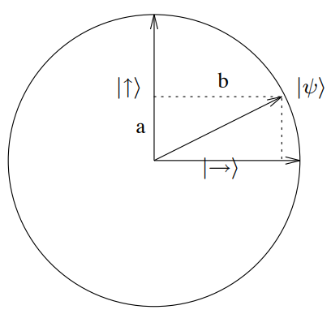
Photon Polarization (3)
Each photon’s polarization state can be modelled by a unit vector pointing in the appropriate direction. Any arbitrary polarization can be expressed as a linear combination a|↑⟩ + b|→⟩ of the two basis vectors |→⟩ and |↑⟩, representing horizontal and vertical polarization, respectively.
The corresponding state vector will be a unit vector, that is, |a|² + |b|² = 1.
When performing a measurement, the state transforms into one of the measuring device’s associated basis vectors (|→⟩ and |↑⟩).
Consequently, the state 𝜓 = a|↑⟩ + b|→⟩ will be measured as |↑⟩ with probability |a|² and as |→⟩ with probability |b|².
However, if for example the measurement of 𝜓 returns |↑⟩, any following measurement will return |↑⟩ with probability 1 since the state 𝜓 has changed after the first measure.

Slide 8
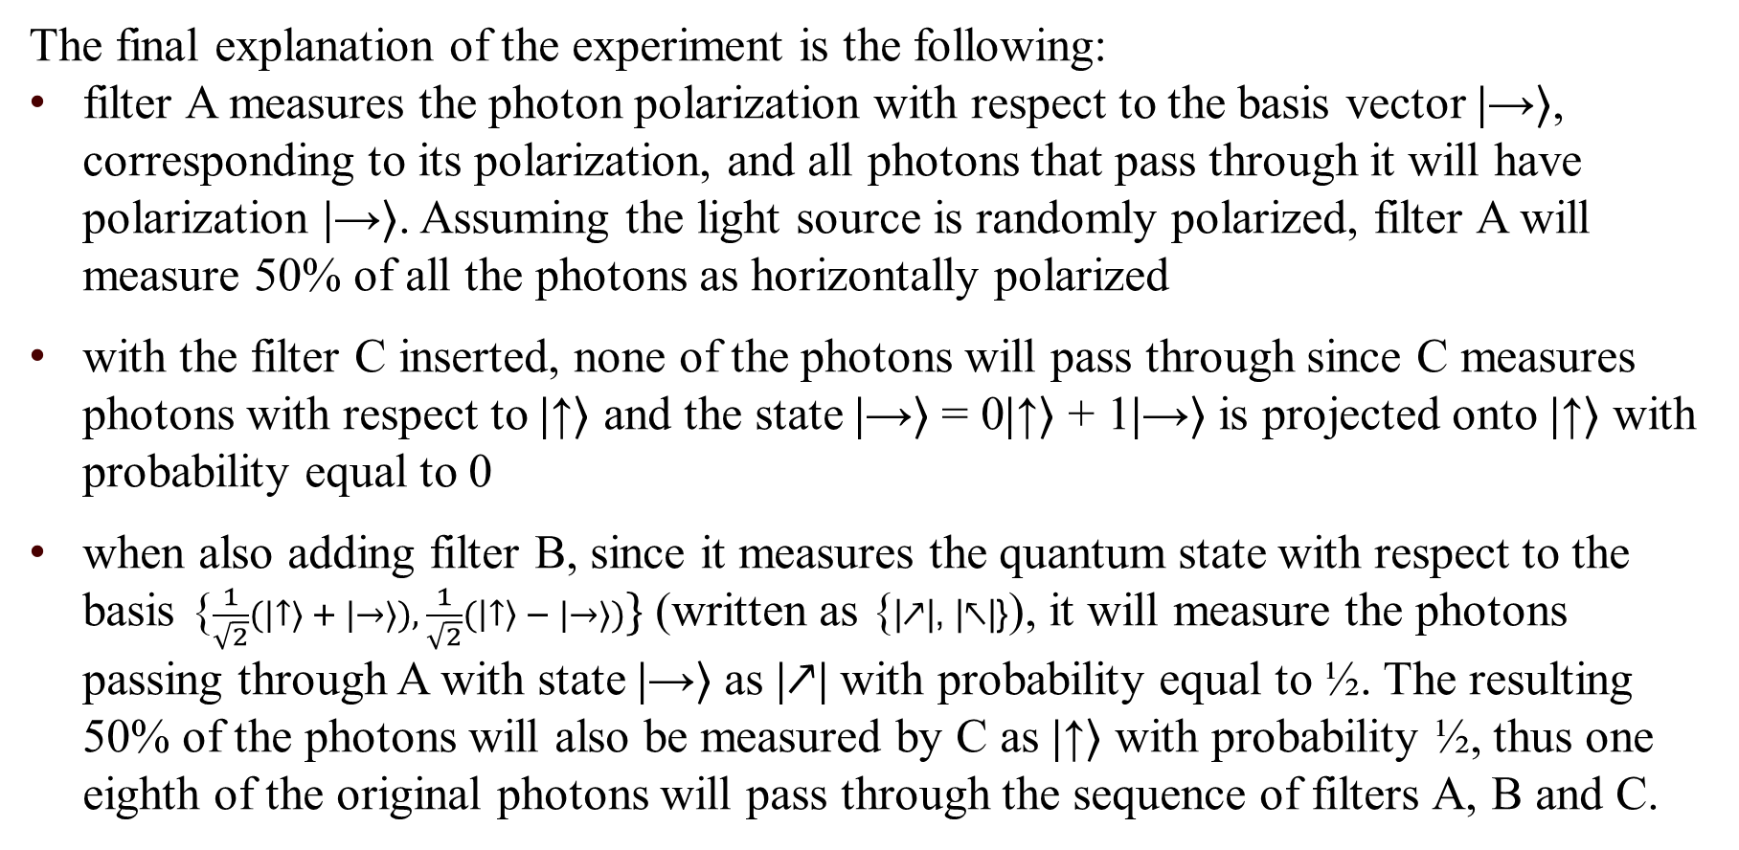
Photon Polarization (4)
The final explanation of the experiment is the following:
filter A measures the photon polarization with respect to the basis vector |→⟩, corresponding to its polarization, and all photons that pass through it will have polarization |→⟩. Assuming the light source is randomly polarized, filter A will measure 50% of all the photons as horizontally polarized
with the filter C inserted, none of the photons will pass through since C measures photons with respect to |↑⟩ and the state |→⟩ = 0|↑⟩ + 1|→⟩ is projected onto |↑⟩ with probability equal to 0
when also adding filter B, since it measures the quantum state with respect to the basis {$\frac{1}{\sqrt{2}}(|↑⟩ + |→⟩), \frac{1}{\sqrt{2}}(\left|↑\right\rangle − |→⟩)\}$ (written as {|↗|, |↖|}), it will measure the photons passing through A with state |→⟩ as |↗| with probability equal to ½. The resulting 50% of the photons will also be measured by C as |↑⟩ with probability ½, thus one eighth of the original photons will pass through the sequence of filters A, B and C.

Slide 9
Bra/Ket Notation
Quantum state spaces and transformations can either be described in terms of vectors and matrices or in the more compact notation invented by Dirac, the bra/ket notation.
This notation includes “bras” and “kets”:
a ket is of the form |x⟩ and denotes column vectors which represent states of the quantum system
a bra, written as ⟨x|, is used to map each vector to a number in the complex plane and denotes the conjugate transpose of |x⟩
The orthonormal basis {|0⟩, |1⟩} can thus be expressed as {(1, 0)^{T} ,(0, 1)^{T}}.
Similarly, any complex linear combination of |0⟩ and |1⟩, that is a|0⟩ + b|1⟩, can be written as (a, b)^{T}.
For the rest of the presentation, |0⟩ will represent (0, 1)^{T} while |1⟩ represents (1, 0)^{T}.

Slide 10
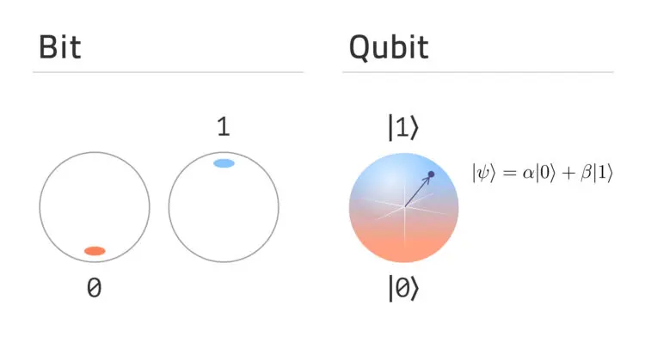
What is a Qubit? (1)
A quantum bit, or qubit, is a unit vector in a two-dimensional complex vector space for which a particular basis, denoted by {|0⟩, |1⟩}, has been fixed.
The orthonormal basis |0⟩ and |1⟩ may correspond to the |↑⟩ and |→⟩ polarizations of a photon or to the polarizations |↗| and |↖|.
For quantum computation, the basis states |0⟩ and |1⟩ are taken to represent the classical bit values 0 and 1, respectively.
Differently from classical bits, qubits can be in a superposition of |0⟩ and |1⟩ such as a|0⟩ + b|1⟩, with a and b representing complex numbers such that |a|² + |b|² = 1.

Slide 11
What is a Qubit? (2)
When a qubit is measured, the measurement changes the state to one of the basis states in the way seen in the photon polarization experiment
Thus, if we want to extract information from a qubit, every measure performed can result in only one of the two states corresponding to the basis vectors of the measuring device
Therefore, although a quantum bit can be put in infinitely many superposition states, it is only possible to extract a single classical bit’s worth of information from a single quantum bit
Additionally, as measurement changes the state, one cannot measure the state of a qubit in two different bases associated with two different measuring devices

Slide 12
Multiple Qubits
Whereas in a classical system of n particles the growth of the state space is linear in the size of the input, resulting in a vector space of 2n dimensions, in a quantum system with n qubits, the total dimensions of the state space is 2^{n}, which is exponential in the number of particles.
If in the first case the state spaces combine through the cartesian product, in the second case quantum states combine through the tensor product:
the state space for two qubits each having basis {|0⟩, |1⟩}, has a resulting basis {|0⟩ ⊗ |0⟩, |0⟩ ⊗ |1⟩, |1⟩ ⊗ |0⟩, |1⟩ ⊗ |1⟩}, also written as {|00⟩, |01⟩, |10⟩, |11⟩}
a basis for a three-qubit system is {|000⟩,|001⟩,|010⟩,|011⟩,|100⟩,|101⟩,|110⟩,|111⟩}
…
It’s easy to notice an exponential growth of the state space with the number of quantum particles, with the tensor product X ⊗ Y having dimension dim(X) × dim(Y).

Slide 13
Entanglement
Entangled states are special states that cannot be described in terms of the state of each of its qubits separately.
In these special states, the measurement of a single qubit influences the measurement of every other entangled qubit:
if we perform the measurement of the state of one qubit, the state of the other qubits will be known, without directly measuring them, and it will depend on the result returned by the first measurement.
Particles are therefore not entangled if the measurement of one particle has no effect on the other particles.
The definition of entanglement can be equivalently given as both in the sense of the measurement of a particle influencing the measurement of another particle, and as states that cannot be written as a tensor product of individual states.

Slide 14

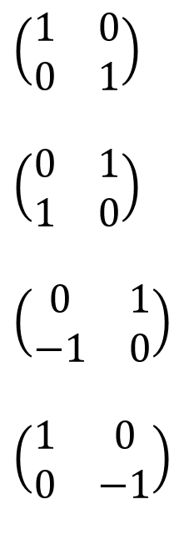
Simple Quantum Gates
A quantum gate is an operation that acts on the qubit, used to manipulate and transform the quantum state of the system.
They can be represented by matrices that describe the linear transformation performed on the quantum state.
Each of these matrices is unitary, that is, the product between the matrix and its conjugate transpose is the identity matrix: M M* = I
Each quantum gate represents a reversible transformation.
Identity
Negation
Y = ZX
Phase Shift
$I:\left|0\right\rangle \text{→} \left|0\right\rangle$
$\left|1\right\rangle \text{→} |1⟩$
$X:\left|0\right\rangle \text{→} \left|1\right\rangle$
$\left|1\right\rangle \text{→} |0⟩$
$Y:\left|0\right\rangle \text{→}−\left|1\right\rangle$
$\left|1\right\rangle \text{→} |0⟩$
$Z:\left|0\right\rangle \text{→} \left|0\right\rangle$
$\left|1\right\rangle \text{→}−|1⟩$
$$\left(\begin{matrix}1 & 0 \\ 0 & 1\end{matrix}\right)$$
$$\left(\begin{matrix}0 & 1 \\ 1 & 0\end{matrix}\right)$$
$$\left(\begin{matrix}0 & 1 \\ −1 & 0\end{matrix}\right)$$
$$\left(\begin{matrix}1 & 0 \\ 0 & −1\end{matrix}\right)$$

Slide 15
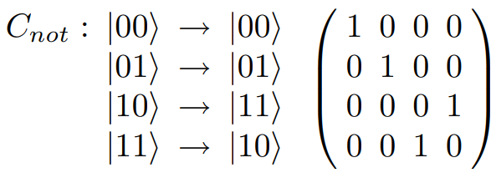
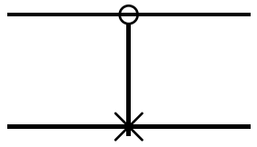
Controlled-NOT Gate
The controlled-NOT gate, written as C_{not} , operates on two qubits in the following way:
if the first bit is equal to 1, it flips the second bit
if the first bit is not equal to 1, it leaves the second bit unchanged
The C_{not} transformation is represented as:
Matrix Notation Circuit Notation

Slide 16
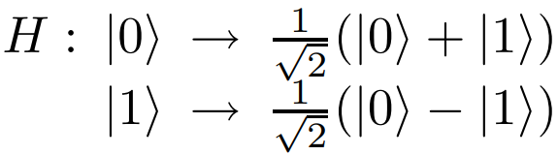
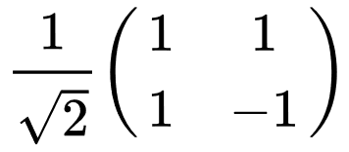
Walsh-Hadamard Transformation
The Walsh-Hadamard Transformation transforms the quantum state of a qubit into a superposition of the two states |0⟩ and |1⟩.
When the transformation is applied to one qubit, it is known as the Hadamard Transformation, H:
The transformation that applies H to n bits is called the Walsh transformation, W, and can be recursively defined as:

Slide 17
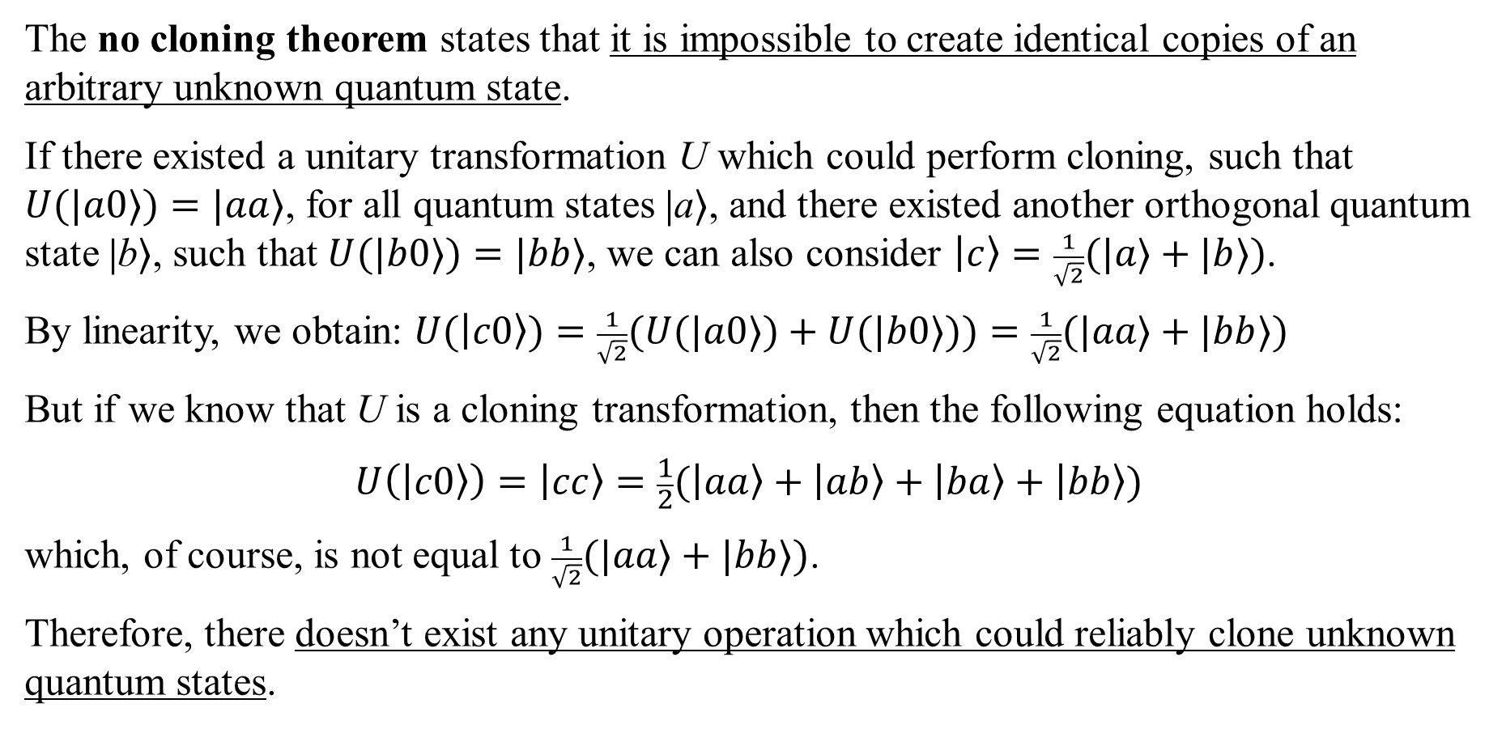
No Cloning Principle
The no cloning theorem states that it is impossible to create identical copies of an arbitrary unknown quantum state.
If there existed a unitary transformation U which could perform cloning, such that $U(|a0⟩)=|aa⟩$, for all quantum states |a⟩, and there existed another orthogonal quantum state |b⟩, such that $U(|b0⟩)=|bb⟩$, we can also consider $\left|c\right\rangle =\frac{1}{\sqrt{2}}(|a⟩+|b⟩)$.
By linearity, we obtain: $U(\left|c0\right\rangle )=\frac{1}{\sqrt{2}}(U(|a0⟩)+U(|b0⟩))=\frac{1}{\sqrt{2}}(|aa⟩+|bb⟩)$
But if we know that U is a cloning transformation, then the following equation holds:
$$U\left(\left|c0\right\rangle \right)=\left|cc\right\rangle =\frac{1}{2}(\left|aa\right\rangle +\left|ab\right\rangle +\left|ba\right\rangle +\left|bb\right\rangle )$$
which, of course, is not equal to $\frac{1}{\sqrt{2}}(|aa⟩+|bb⟩)$.
Therefore, there doesn’t exist any unitary operation which could reliably clone unknown quantum states.

Slide 18
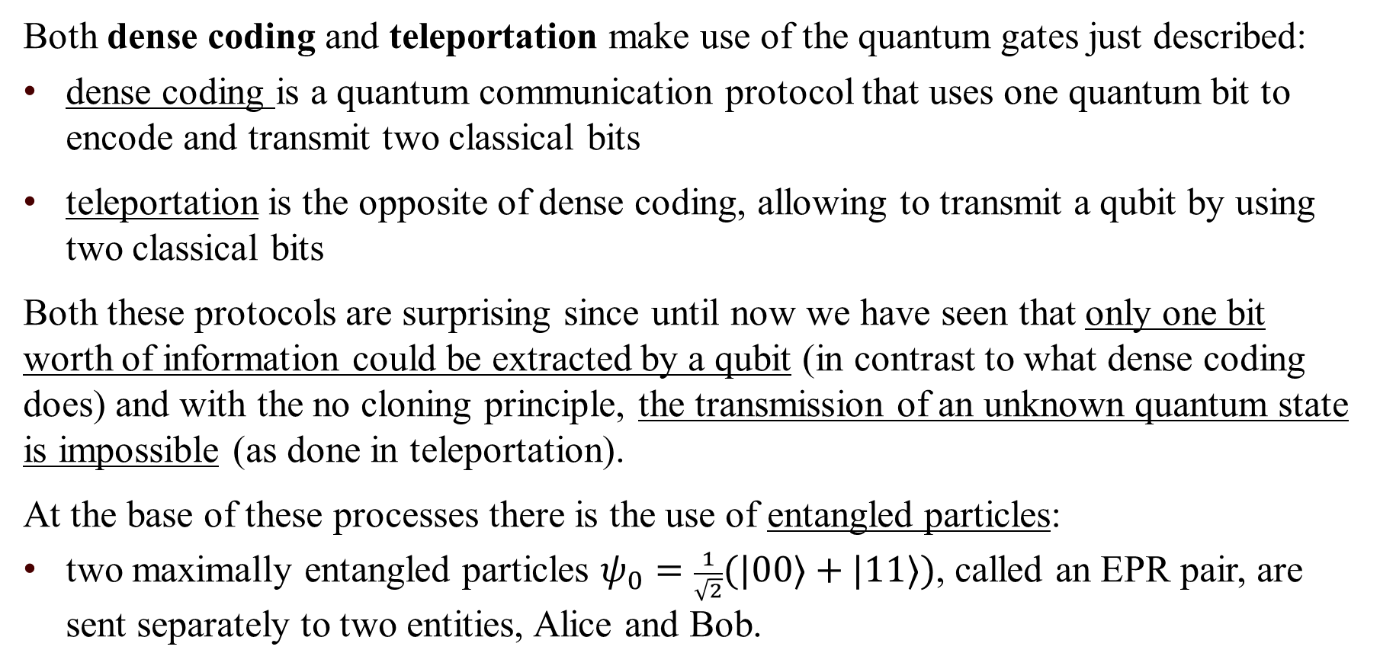
Dense Coding and Teleportation
Both dense coding and teleportation make use of the quantum gates just described:
dense coding is a quantum communication protocol that uses one quantum bit to encode and transmit two classical bits
teleportation is the opposite of dense coding, allowing to transmit a qubit by using two classical bits
Both these protocols are surprising since until now we have seen that only one bit worth of information could be extracted by a qubit (in contrast to what dense coding does) and with the no cloning principle, the transmission of an unknown quantum state is impossible (as done in teleportation).
At the base of these processes there is the use of entangled particles:
two maximally entangled particles $ψ_{0}=\frac{1}{\sqrt{2}}(|00⟩+|11⟩)$, called an EPR pair, are sent separately to two entities, Alice and Bob.

Slide 19
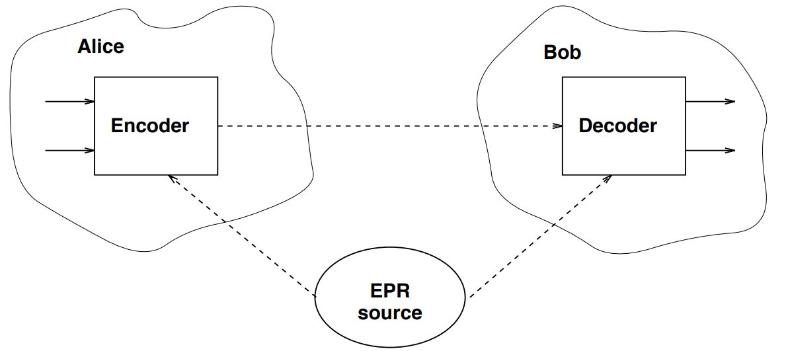
Dense Coding (1)
The schema of the dense coding communication protocol is the following:
Alice receives two classical bits, and she wants to send them through a qubit to Bob
both Alice and Bob receive an entangled particle from the EPR pair source
Bob receives the qubit from Alice and can obtain the two classical bits

Slide 20
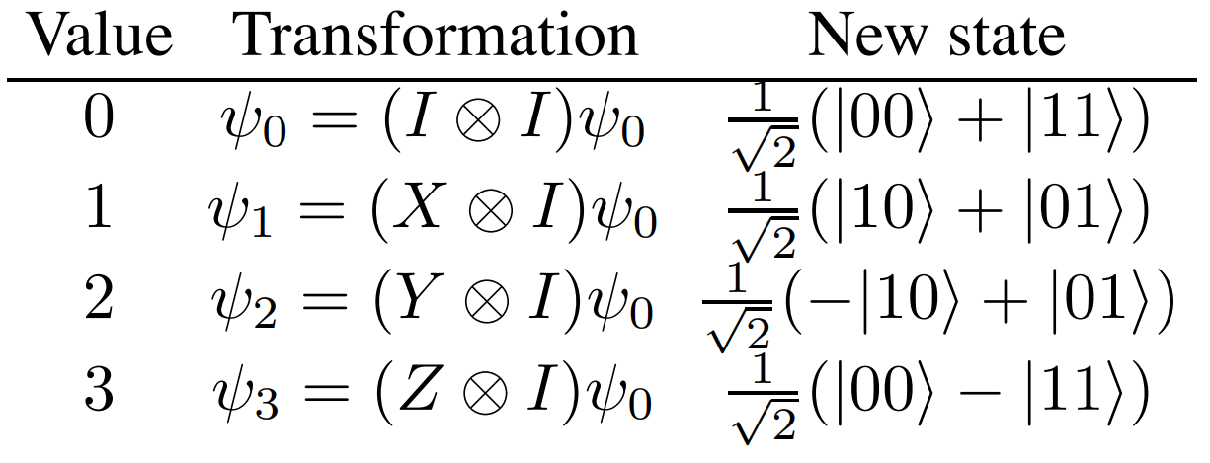
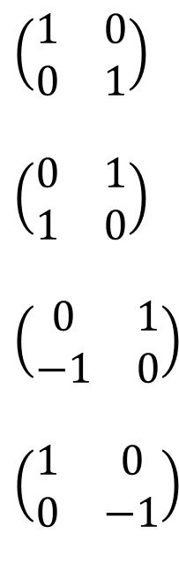

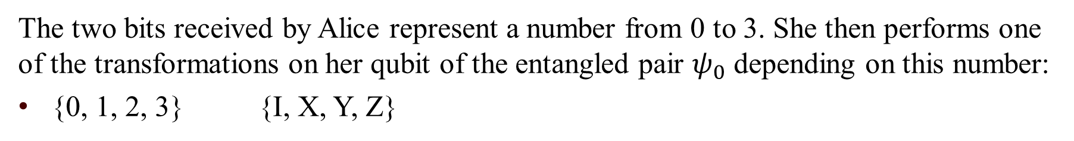
Dense Coding (2)
The two bits received by Alice represent a number from 0 to 3. She then performs one of the transformations on her qubit of the entangled pair $ψ_{0}$ depending on this number:
{0, 1, 2, 3} {I, X, Y, Z}
Identity
Negation
Y = ZX
Phase Shift
$I:\left|0\right\rangle \text{→} \left|0\right\rangle$
$\left|1\right\rangle \text{→} |1⟩$
$X:\left|0\right\rangle \text{→} \left|1\right\rangle$
$\left|1\right\rangle \text{→} |0⟩$
$Y:\left|0\right\rangle \text{→}−\left|1\right\rangle$
$\left|1\right\rangle \text{→} |0⟩$
$Z:\left|0\right\rangle \text{→} \left|0\right\rangle$
$\left|1\right\rangle \text{→}−|1⟩$
$$\left(\begin{matrix}1 & 0 \\ 0 & 1\end{matrix}\right)$$
$$\left(\begin{matrix}0 & 1 \\ 1 & 0\end{matrix}\right)$$
$$\left(\begin{matrix}0 & 1 \\ −1 & 0\end{matrix}\right)$$
$$\left(\begin{matrix}1 & 0 \\ 0 & −1\end{matrix}\right)$$
Alice then sends her qubit to Bob.

Slide 21
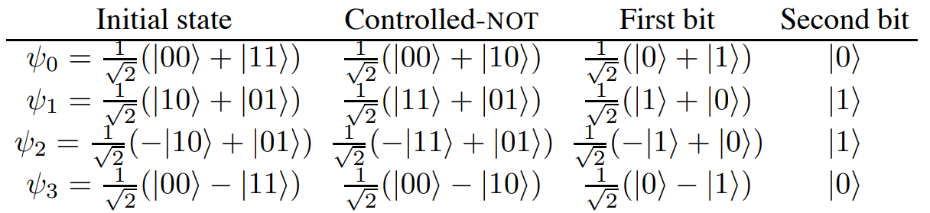
Dense Coding (3)
Bob can apply a controlled-NOT to the two qubits of the entangled pair. Bob can now measure the second qubit without disturbing the quantum state:
if the measurement of the second qubit returns |0⟩, then the original encoded value was either 0 or 3
if the measurement returns |1⟩, then the value was either 1 or 2

Slide 22
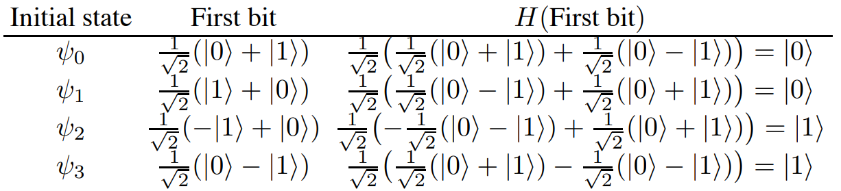
Dense Coding (4)
Bob now applies the Hadamard gate to the first qubit, which allows him to distinguish between the four encoded values.
With the measurement of the first bit, Bob can finally distinguish between 0 and 3, and 1 and 2.

Slide 23
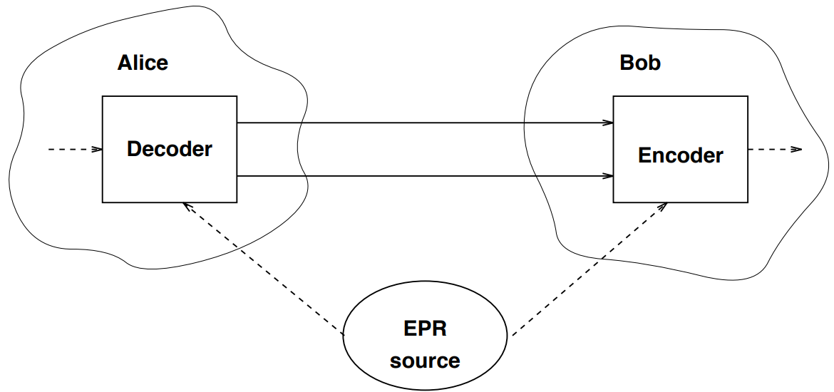

Teleportation (1)
The schema of the teleportation communication protocol is similar to the one of dense coding:
Alice has a qubit whose state she doesn’t know
Alice wants to send, using classical channels, the state of her qubit $φ$ = a|0⟩ + b|1⟩ to Bob
As with dense coding, Bob and Alice share an entangled pair $ψ_{0}=\frac{1}{\sqrt{2}}(|00⟩+|11⟩)$

Slide 24
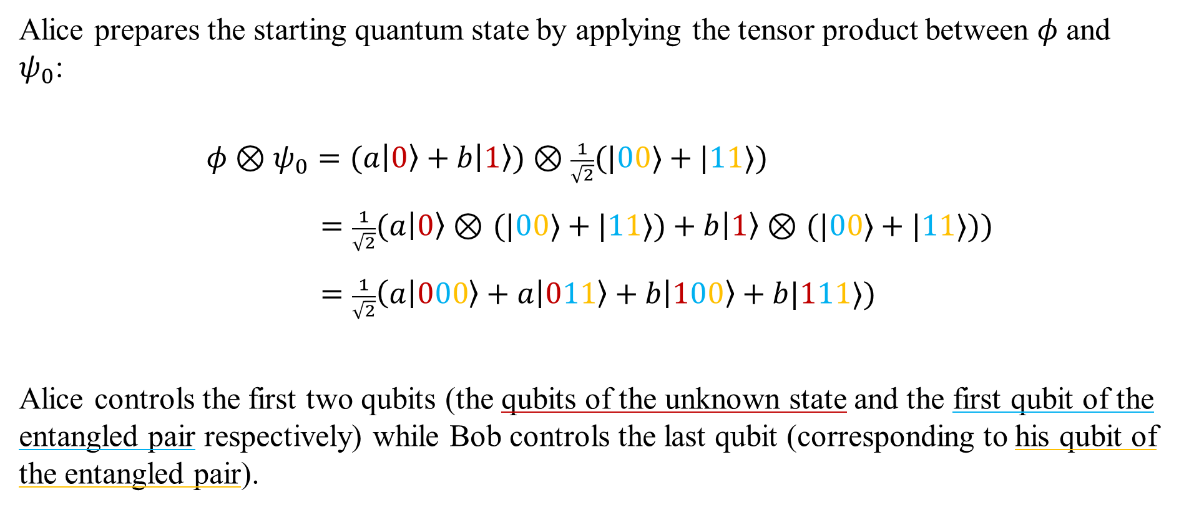
Teleportation (2)
Alice prepares the starting quantum state by applying the tensor product between $φ$ and $ψ_{0}$:
$φ \text{⊗} ψ_{0}=(a\left|0\right\rangle +b\left|1\right\rangle \text{) }\text{⊗} \frac{1}{\sqrt{2}}(|00⟩+|11⟩)$
$=\frac{1}{\sqrt{2}}(a\left|0\right\rangle \text{⊗} (|00⟩+|11⟩)+b\left|1\right\rangle \text{⊗} (|00⟩+|11⟩))$
$=\frac{1}{\sqrt{2}}\left(a | 000\right\rangle +a\left|011\right\rangle +b\left|100\right\rangle +b|111⟩)$
Alice controls the first two qubits (the qubits of the unknown state and the first qubit of the entangled pair respectively) while Bob controls the last qubit (corresponding to his qubit of the entangled pair).

Slide 25
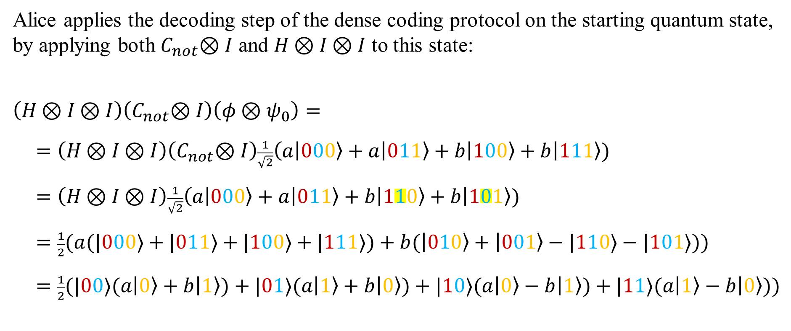
Teleportation (3)
Alice applies the decoding step of the dense coding protocol on the starting quantum state, by applying both $C_{not}\text{⊗} I$ and $H \text{⊗} I \text{⊗} I$ to this state:
$\left(H \text{⊗} I \text{⊗} I\right)\left(C_{not}\text{⊗} I\right)\left(φ \text{⊗} ψ_{0}\right)=$
$=\left(H \text{⊗} I \text{⊗} I\right)\left(C_{not}\text{⊗} I\right)\frac{1}{\sqrt{2}}\left(a | 000\right\rangle +a\left|011\right\rangle +b\left|100\right\rangle +b\left|111\right\rangle )$
$=\left(H \text{⊗} I \text{⊗} I\right)\frac{1}{\sqrt{2}}\left(a | 000\right\rangle +a\left|011\right\rangle +b\left|110\right\rangle +b\left|101\right\rangle )$
$=\frac{1}{2}(a(|000⟩+|011⟩+|100⟩+|111⟩)+b(\left|010\right\rangle +\left|001\right\rangle −|110⟩−|101⟩))$
$=\frac{1}{2}(|00⟩(a\left|0\right\rangle +b\left|1\right\rangle )+|01⟩(a\left|1\right\rangle +b\left|0\right\rangle )+|10⟩(a\left|0\right\rangle −b\left|1\right\rangle )+|11⟩(a\left|1\right\rangle −b\left|0\right\rangle ))$

Slide 26
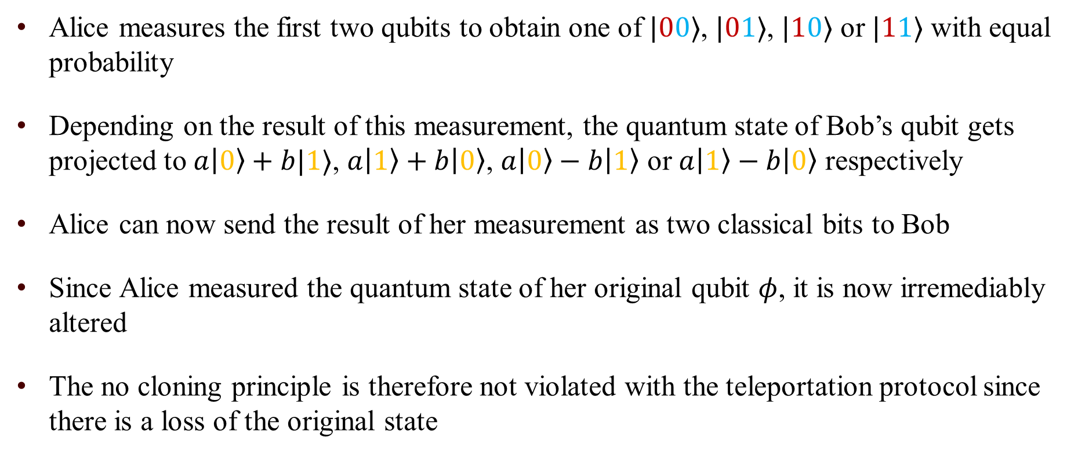
Teleportation (4)
Alice measures the first two qubits to obtain one of $|00⟩$, $|01⟩$, $|10⟩$ or $|11⟩$ with equal probability
Depending on the result of this measurement, the quantum state of Bob’s qubit gets projected to $a\left|0\right\rangle +b|1⟩$, $a\left|1\right\rangle +b\left|0\right\rangle$, $a\left|0\right\rangle −b\left|1\right\rangle$ or $a\left|1\right\rangle −b\left|0\right\rangle$ respectively
Alice can now send the result of her measurement as two classical bits to Bob
Since Alice measured the quantum state of her original qubit $φ$, it is now irremediably altered
The no cloning principle is therefore not violated with the teleportation protocol since there is a loss of the original state

Slide 27
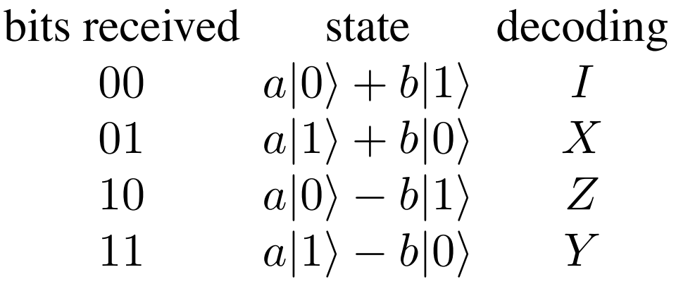

Teleportation (5)
When Bob receives the two classical bits from Alice, he gains the knowledge on how the state of his qubit of the entangled pair compares to the original state of Alice’s qubit:
Bob can now reconstruct the original state of $φ$, Alice’s qubit, by applying the appropriate decoding transformation to his qubit of the entangled pair.
This step corresponds to the encoding step of dense coding.

Slide 28
Security of Dense Coding and Teleportation
Both dense coding and teleportation represent a secure mean of communication in quantum coding, eliminating the possibility of eavesdroppers to intercept messages:
if the adversary, which we refer to as Eve, intercepts Alice’s qubit, she gets in possession only of half of the entangled state
without having access to the other half, which is Bob’s qubit, Eve is unable to extract any information from Alice’s qubit (Bob’s qubit is necessary to decode it)
additionally, any attempt performed by Eve to measure either qubit would collapse the state of said qubit, ultimately alerting both Alice and Bob
the same consideration apply in the case of teleportation, where Eve can intercept the two classical bits sent by Alice without being able to reconstruct the original quantum state

Slide 29
Thank you for the attention

